Slide 1

Applied Data Science Capstone
MUHAMMAD Ghufran Akbar
Coursera

Slide 2
Business Problem
As the number of vehicles increases, so also does traffic accidents. Some of the things that play a significant part in traffic accidents
number of vehicles
weather conditions
lighting
road conditions
There is a need for a program to predict the severity of an accident based on historical data.

Slide 3
Data
The dataset contains 194,673 rows that contain historical data of prior accidents.
There are 37 attributes in the dataset.
Severity is the dependent variable

Slide 4
Data – Logistic Regression Variables
SEVERITYCODE A code that corresponds to the severity of the collision: 1 or 2
PERSONCOUNT The total number of people involved in the collision
PEDCOUNT The number of pedestrians involved in the collision
PEDCYLCOUNT The number of bicycles involved in the collision
VEHCOUNT The number of vehicles involved in the collision
SDOT_COLCODE A code is given to the collision by SDOT
HITPARKEDCAR Whether or not the collision involved hitting a parked car (Y/N)

Slide 5
SDOT Code
Code | Description
0 | Vehicle Going Straight Hits Pedestrian
1 | Vehicle Turning Right Hits Pedestrian
2 | Vehicle Turning Left Hits Pedestrian
3 | Vehicle Backing Hits Pedestrian
4 | Vehicle Hits Pedestrian - All Other Actions
5 | Vehicle Hits Pedestrian - Actions Not Stated
10 | Entering At Angle
11 | From Same Direction -Both Going Straight -Both Moving- Sideswipe
12 | From Same Direction -Both Going Straight - One Stopped- Sideswipe
13 | From Same Direction - Both Going Straight - Both Moving - Rear End
14 | From Same Direction - Both Going Straight - One Stopped - Rear End
15 | From Same Direction - One Left Turn - One Straight

Slide 6
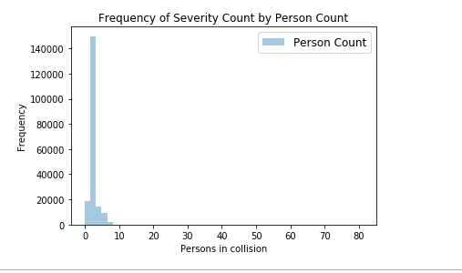

Slide 7
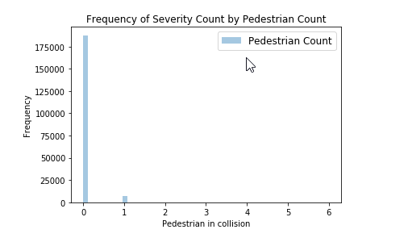

Slide 8
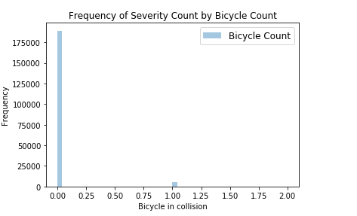

Slide 9
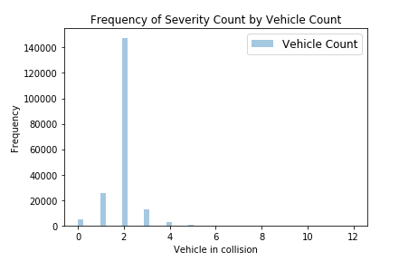

Slide 10
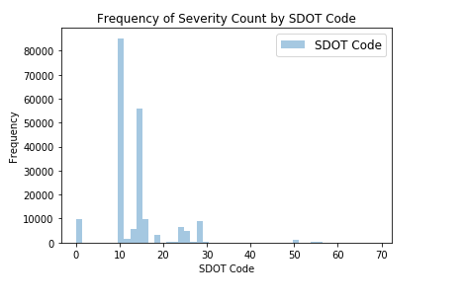

Slide 11
SDOT codes
Code | Description
0 | Vehicle Going Straight Hits Pedestrian
1 | Vehicle Turning Right Hits Pedestrian
2 | Vehicle Turning Left Hits Pedestrian
3 | Vehicle Backing Hits Pedestrian
4 | Vehicle Hits Pedestrian - All Other Actions
5 | Vehicle Hits Pedestrian - Actions Not Stated
10 | Entering At Angle
11 | From Same Direction -Both Going Straight -Both Moving- Sideswipe
12 | From Same Direction -Both Going Straight - One Stopped- Sideswipe
13 | From Same Direction - Both Going Straight - Both Moving - Rear End
14 | From Same Direction - Both Going Straight - One Stopped - Rear End
15 | From Same Direction - One Left Turn - One Straight

Slide 12
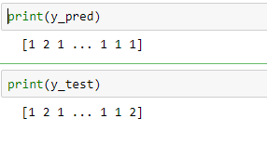
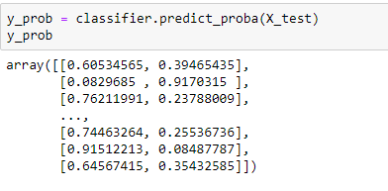
Predication and Probability

Slide 13


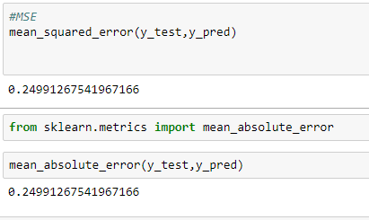

Model Evaluation Confusion Matrix, F1_Score, Jaccard MSE & MAE

Slide 14
Logistic Regression Equation
SEVERITYCODE = -0.89563683
+ 0.15413352 * HITPARKEDCAR
+ 0.36363814 * PERSONCOUNT
+ 0.6144165 * PEDCOUNT
+ 0.47101853 * PEDCYLCOUNT
+ 0.09347897 * VEHCOUNT
+ 0.2153142 * SDOT_COLCODE

Slide 15
Conclusion
The coefficient’s, pedestrian accidents are the most significate in the model for severity
Most collisions are two vehicle collisions
Most collisions are ST_CODE = 10, “Entered at a Angle”

